Slide 1

DESIGN AND FABRICATION OF A SUGARCANE HARVESTING CUTTING MACHINE
Project members:
BATCH 11
NAME | REGISTER NUMBER
VIGNESHWARAN.S | 811722114049
RAJARETHINAM.S | 811722114034
RISHI.B | 811722114036
DHIVAGAR.R | 811722114013
Guided by:
Mr.G. Arun Kumar
Assisstant professor
KRCT

Slide 2
Contents of presentation
CONTENT | SLIDE NUMBER
Abstract | 3
Objective | 4
Problem Identification | 5
Methodology overview | 6
Methodology | 7
Fertilizer | 8
GA DRAWING | 9
Conclusion | 10

Slide 3
Abstract
Sugarcane harvesting is traditionally labor-intensive, leading to high costs and inefficiencies.
Manual harvesting methods result in prolonged operational time and inconsistent crop quality.
The proposed sugarcane harvesting machine aims to mechanize the process for improved productivity.
Key features include precise cutting, efficient collection, and minimized crop damage.
This innovation supports sustainable and scalable farming practices, addressing modern agricultural challenges.

Slide 4
Objective
Conventional Methods: Replace manual harvesting with a faster, mechanized solution.
Health Issues: Minimize health risks from strenuous labor and harsh conditions.
Labor Charges: Reduce high labor costs for farmers.
Large-Scale Harvesting: Efficiently handle workloads exceeding 50 tons.
Cost-Effectiveness: Provide an affordable solution at Rs. 30,500.

Slide 5
Problem Identification
• Manual harvesting is labor-intensive and costly.
• High risk of damaging cane and roots with traditional methods.
• Shortage of skilled labor in many regions.
• Diverse field conditions require adaptable machinery.

Slide 6
Methodology Overview
1. Research and Analysis:
Review existing technologies and gather requirements.
2. Conceptual Design:
Develop initial design concepts and CAD models.
3. Material Selection:
Select materials based on strength, durability, and cost.
4. Fabrication:
Use machining and welding techniques to build components.
5. Testing and Optimization:
Conduct field tests and make necessary adjustments.
6. Safety and Compliance:
Ensure adherence to safety standards and regulations.

Slide 7
METHODOLOGY
METHODOLOGY
SURVEY ON EXISTING SET UP
PROBLEM IDENTIFICATION
OBJECTIVE
2D DESIGN
MATERIAL SELECTION
DESIGN CALCULATION
REPORT

Slide 8
Key Features of the Fertilizer System
Automated Dispensing
Precise delivery of fertilizer during the harvesting process.
Ensures even distribution, promoting uniform crop growth.
Adjustable Flow Mechanism
Customizable settings to control the amount of fertilizer based on soil and crop requirements.
Reduces wastage and ensures optimal nutrient supply.
On board Storage
Compact storage tank for fertilizers, integrated into the machine's design.
Easy to refill and maintain.
Eco-Friendly Design
Promotes sustainable farming by reducing chemical runoff.
Enhances soil fertility and long-term productivity.

Slide 9
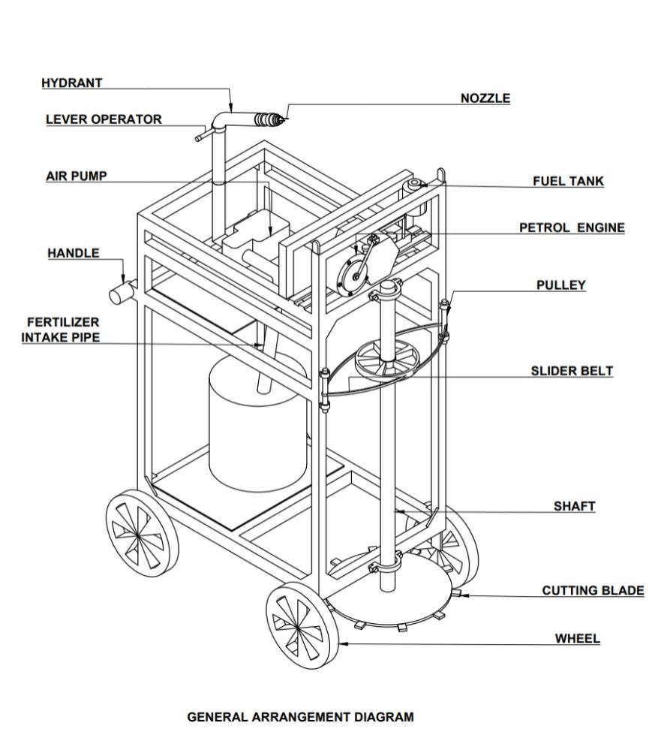
GA DRAWING
GA DRAWING

Slide 10
CONCLUSION
The Sugarcane Harvesting Machine is an efficient, cost-effective solution for small-scale farmers, designed using durable materials and standard engineering principles.
With a total cost of Rs. 30,500, it reduces labor, increases productivity, and supports sustainable agriculture through a compact and robust design.

Slide 11
THANK YOU !

